Slide 1

Alex Keselman (Supervisor)
Raz Ben-Aharon
Dor Toizner
CAPSTONE PROJECT PHASE 2
24-1-D-24

Slide 2
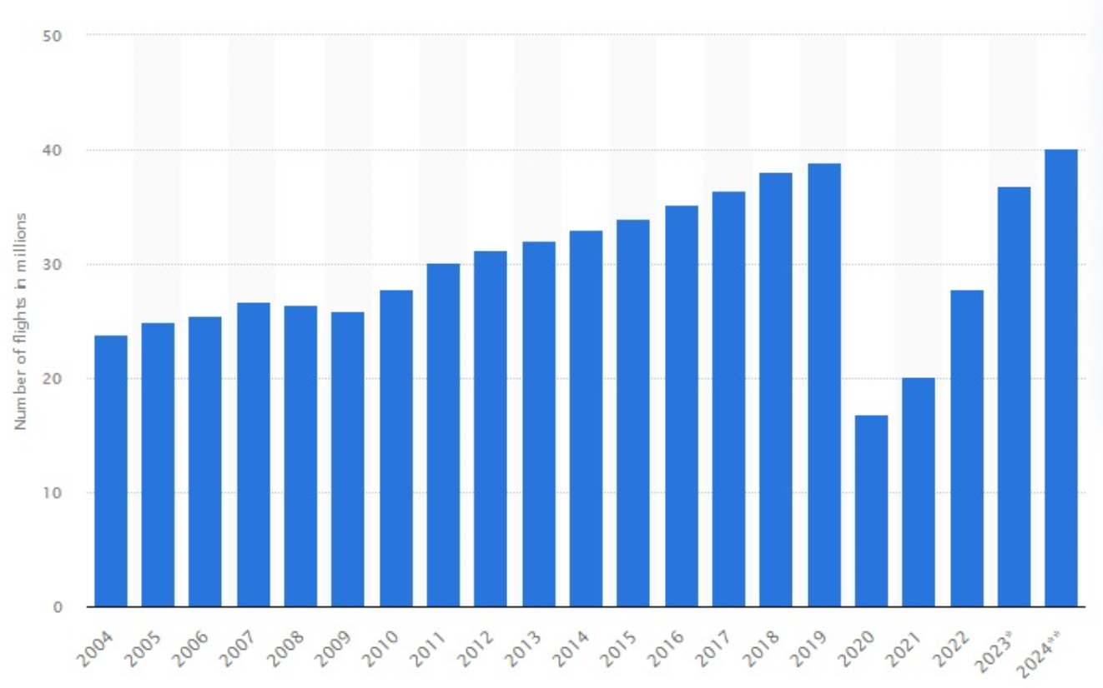
Background
The demand for vacations abroad raised significantly
4.7 billion people are expected to travel in 2024
Worldwide events such as Olympic games, EURO etc.
The demand for digital booking has raised respectively
New low-cost companies have been established
Notes:
Before we start, let’s have a short background introduction.
The demand for vacations abroad has raised significantly during the past years.
4.7 billion people are expected to travel around the world in 2024 which is almost 3 times the amount of people who traveled in 2019.
Worldwide events such as Olympic games, EURO and more have a straight influence about the raising in the number of flights and vacations.
As the demand for vacations raised, the demand for digital booking has raised too.
And lastly, new low-cost companies that have been established cause a bigger price competition among the customers

Slide 3

Problem
Booking a vacation requires several tasks
Each task has a wide range of websites
Generic results doesn’t fit the customer’s needs
Difficult to determine which websites are reliable
Notes:
So, what is the problem ? We found that booking a vacation requires several tasks such as flight or hotel booking.
Each task itself has a wide range of websites to search and compare prices
Another problem is that when you search a hotel for example, you don’t get the results that fit for your needs
And lastly, it is difficult to determine which websites are reliable and which are not

Slide 4

Solution
Uniting all travel tasks into one website
Smart search engine for flights and accommodations
Adjust the results for the customer needs
Provide reliable websites based on reviews
Notes:
The solution we suggest is Vacation Quest.
We are uniting all the travel tasks into one website, so the customer will have the most easy and convenient way to book his vacation.
We developed a smart search engine for flights and accommodations.
We adjust the results for the customer needs so the customer will get the perfect match for him.
And we provided reliable websites bases on reviews.

Slide 5







Project technologies
React.js
Next.js
Tailwind CSS
MongoDB
JinaAI
RapidAPI
AWS
Notes:
The technologies we are using are: React and Next.js for the back-end.
Tailwind CSS for styling the front-end and UI.
MongoDB for storing all the information.
JinaAI for embedding the searching queries.
RapidAPI for collecting real and updated flight and accommodation results.
AWS for deploying our website.
And now Dor will continue to talk about our project flow.

Slide 6
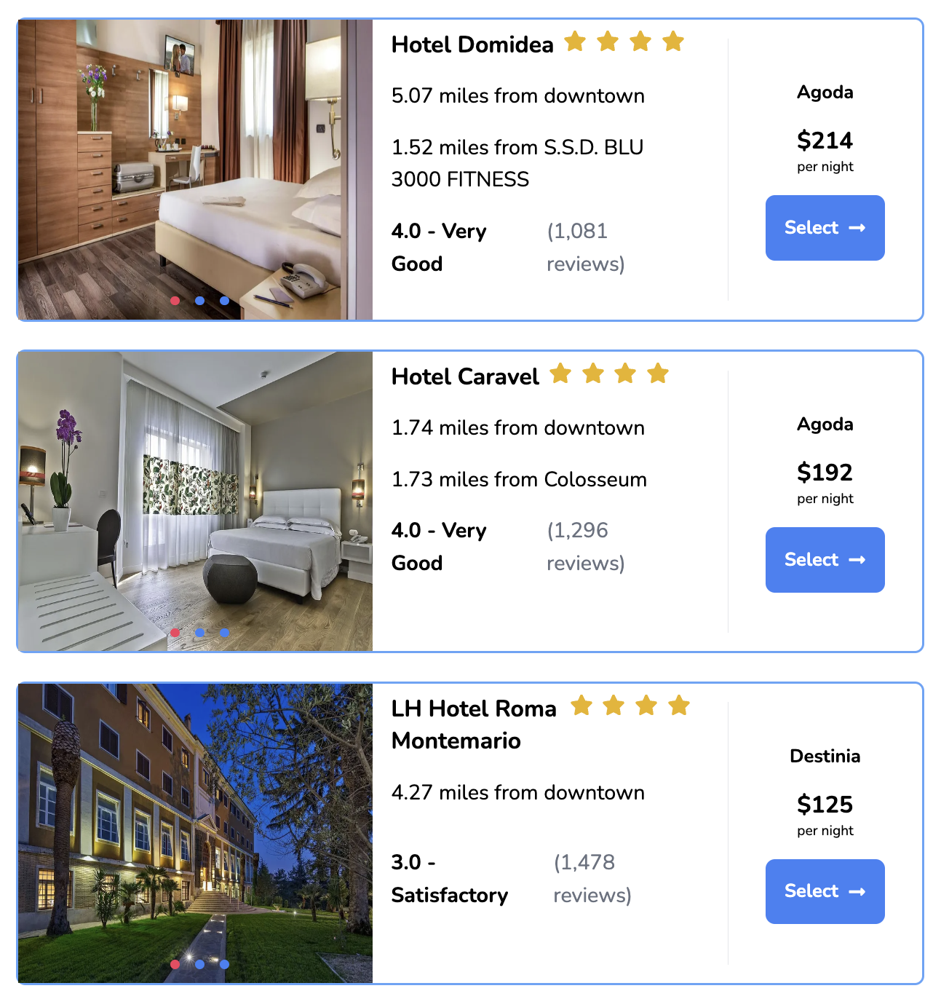
Project Flow
Register/Login
Collect Preferences
Search Vacation
Embbeded Query
Recommendation System
Flights API
Hotels API

Slide 7
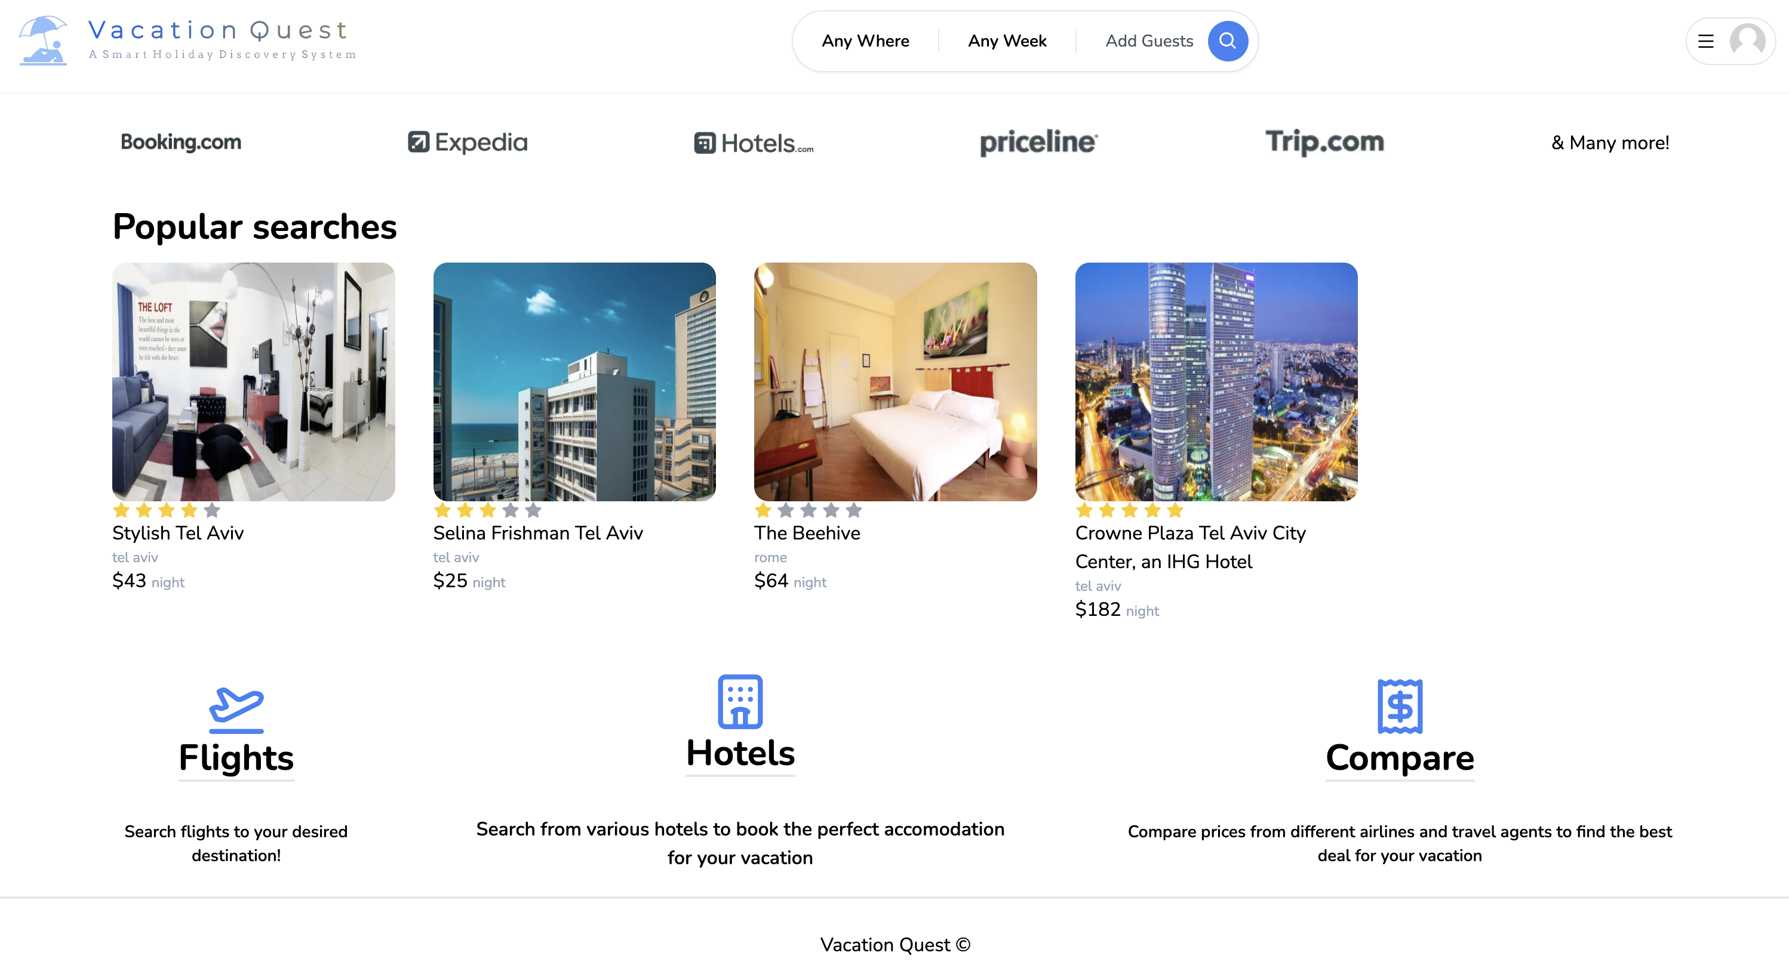
Implementation - Home page

Slide 8
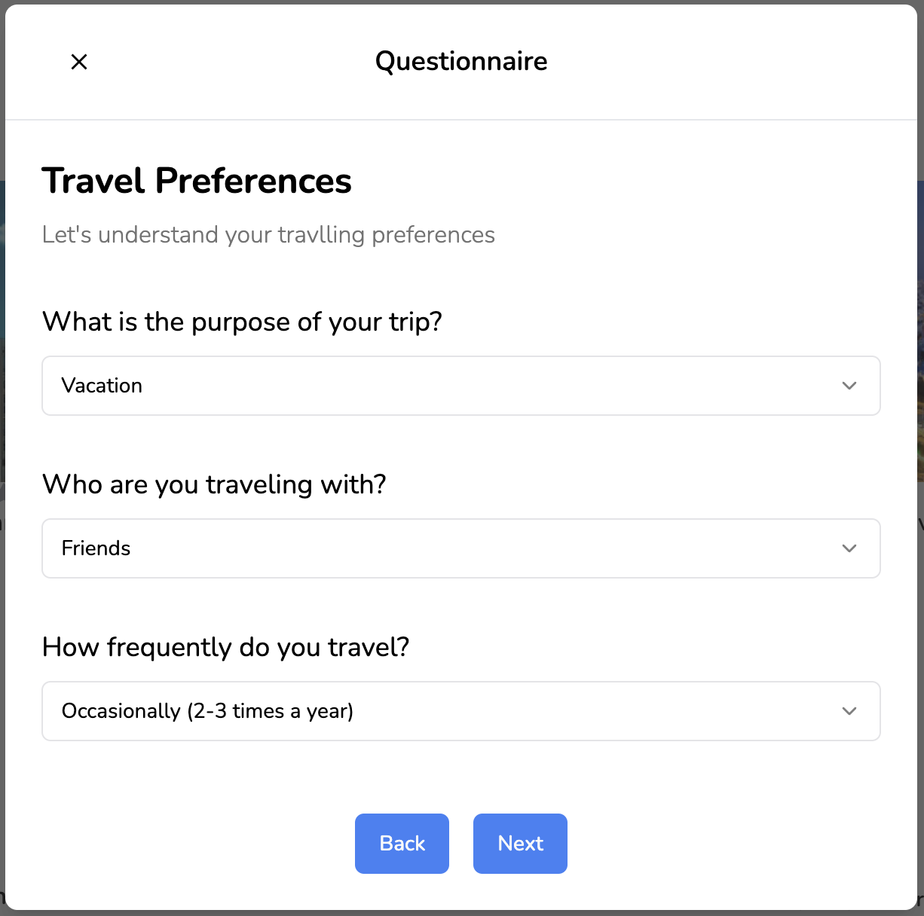
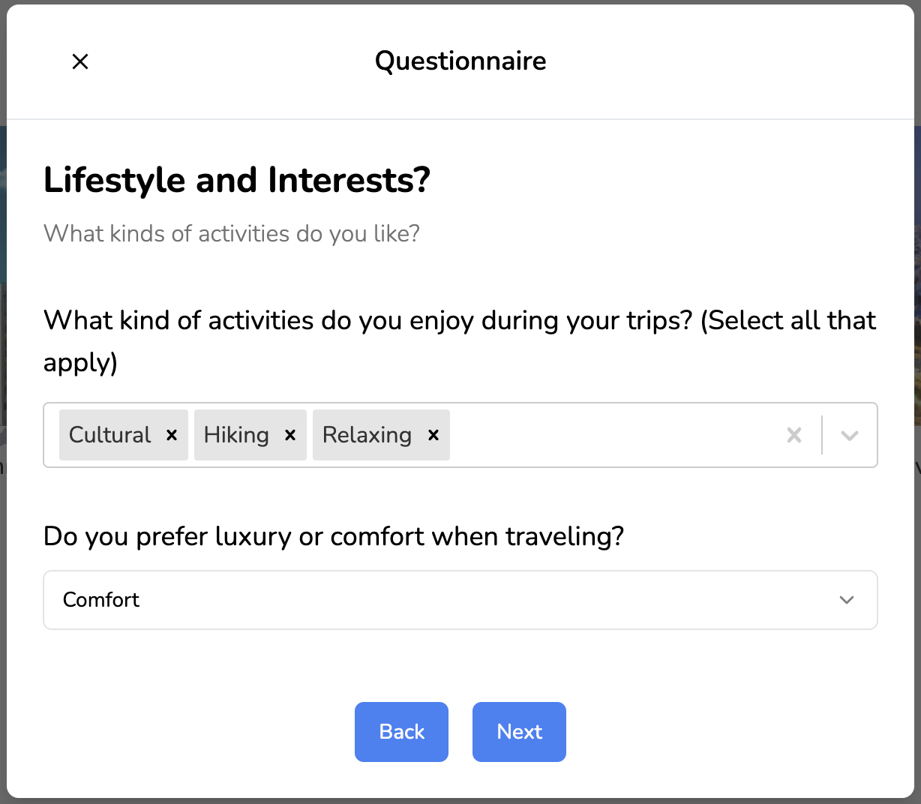
Implementation - Questionnaire

Slide 9
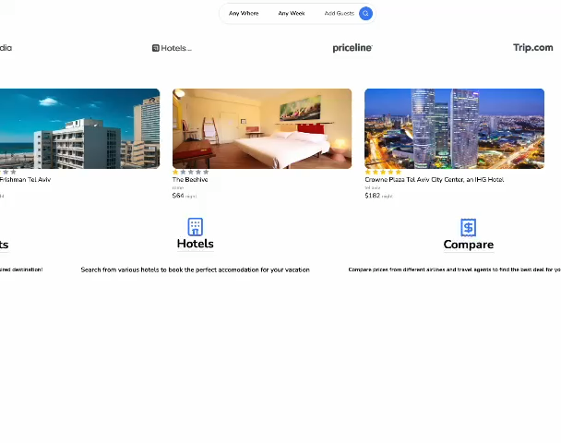
Implementation – Search vacation

Slide 10
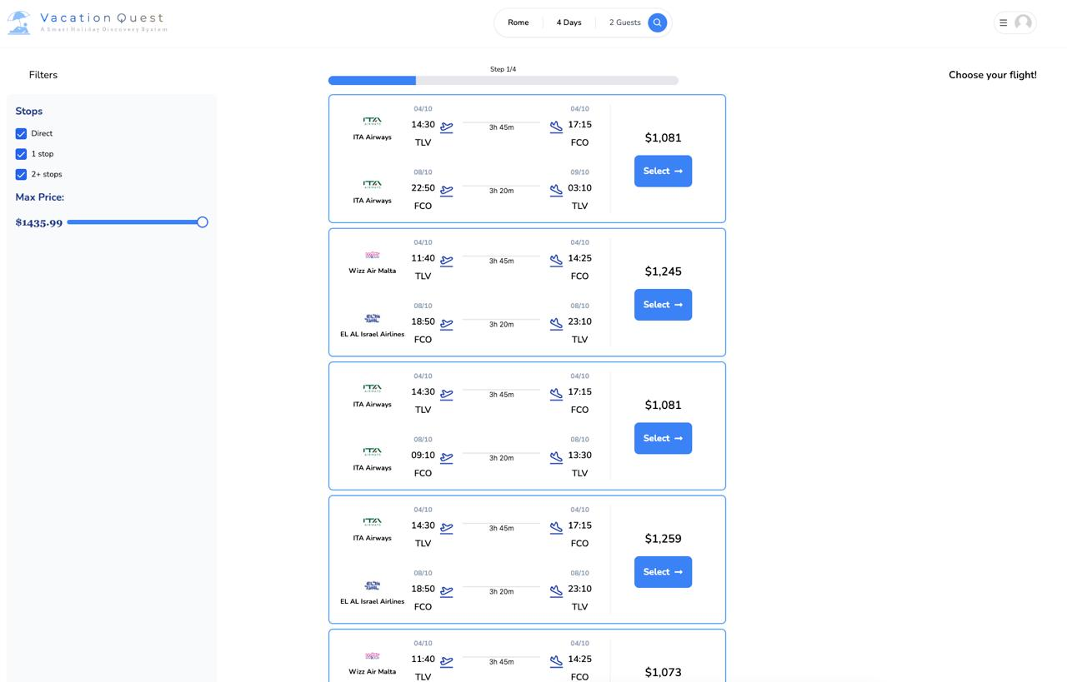
Implementation – Flights results

Slide 11
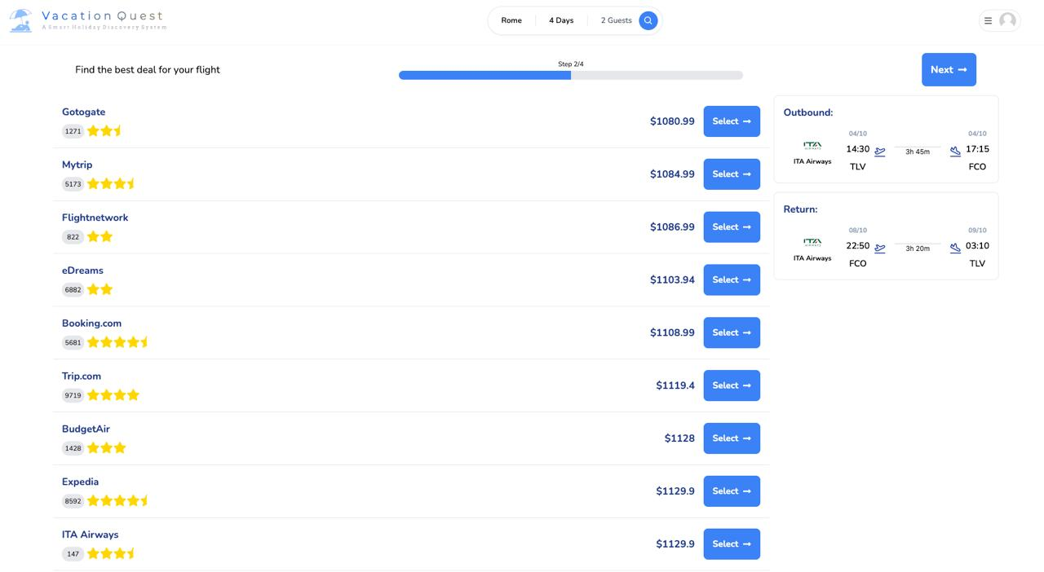

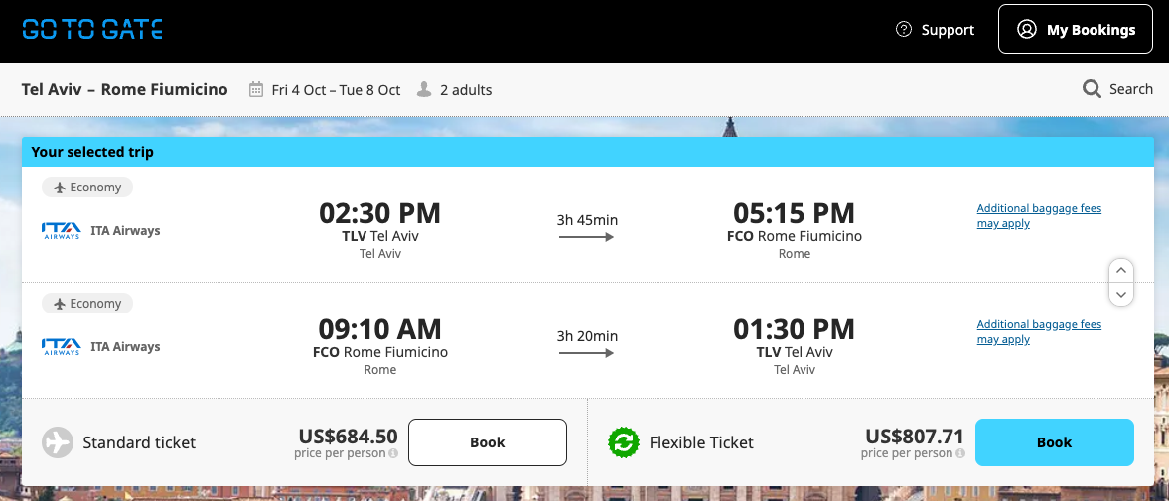
Implementation – Flight deal comparison

Slide 12
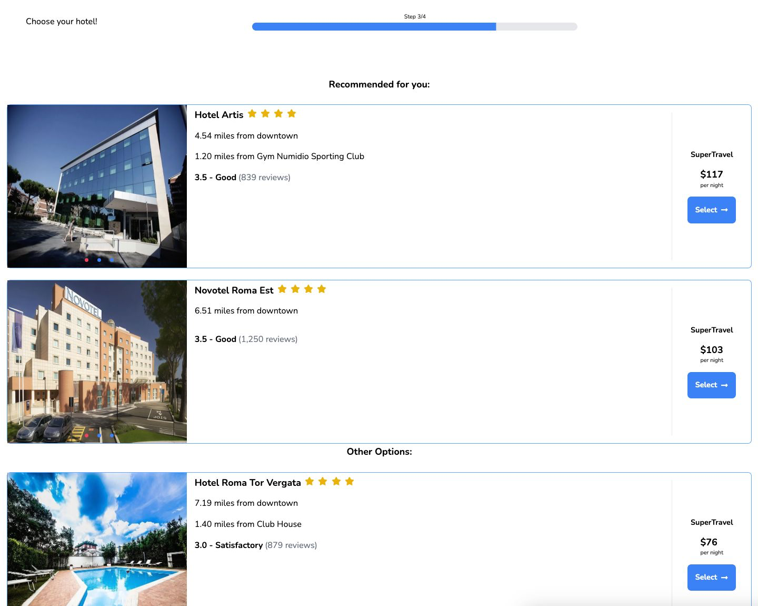
Implementation – Accommodations results
Notes:
So straight from our flight deal page, we get to our hotels page.
Here we can see that JinaAI has recommended to the customer some hotels that may fit to his needs based on his questionnaire and searching history.
And down here we can see other hotels that our API brought.

Slide 13
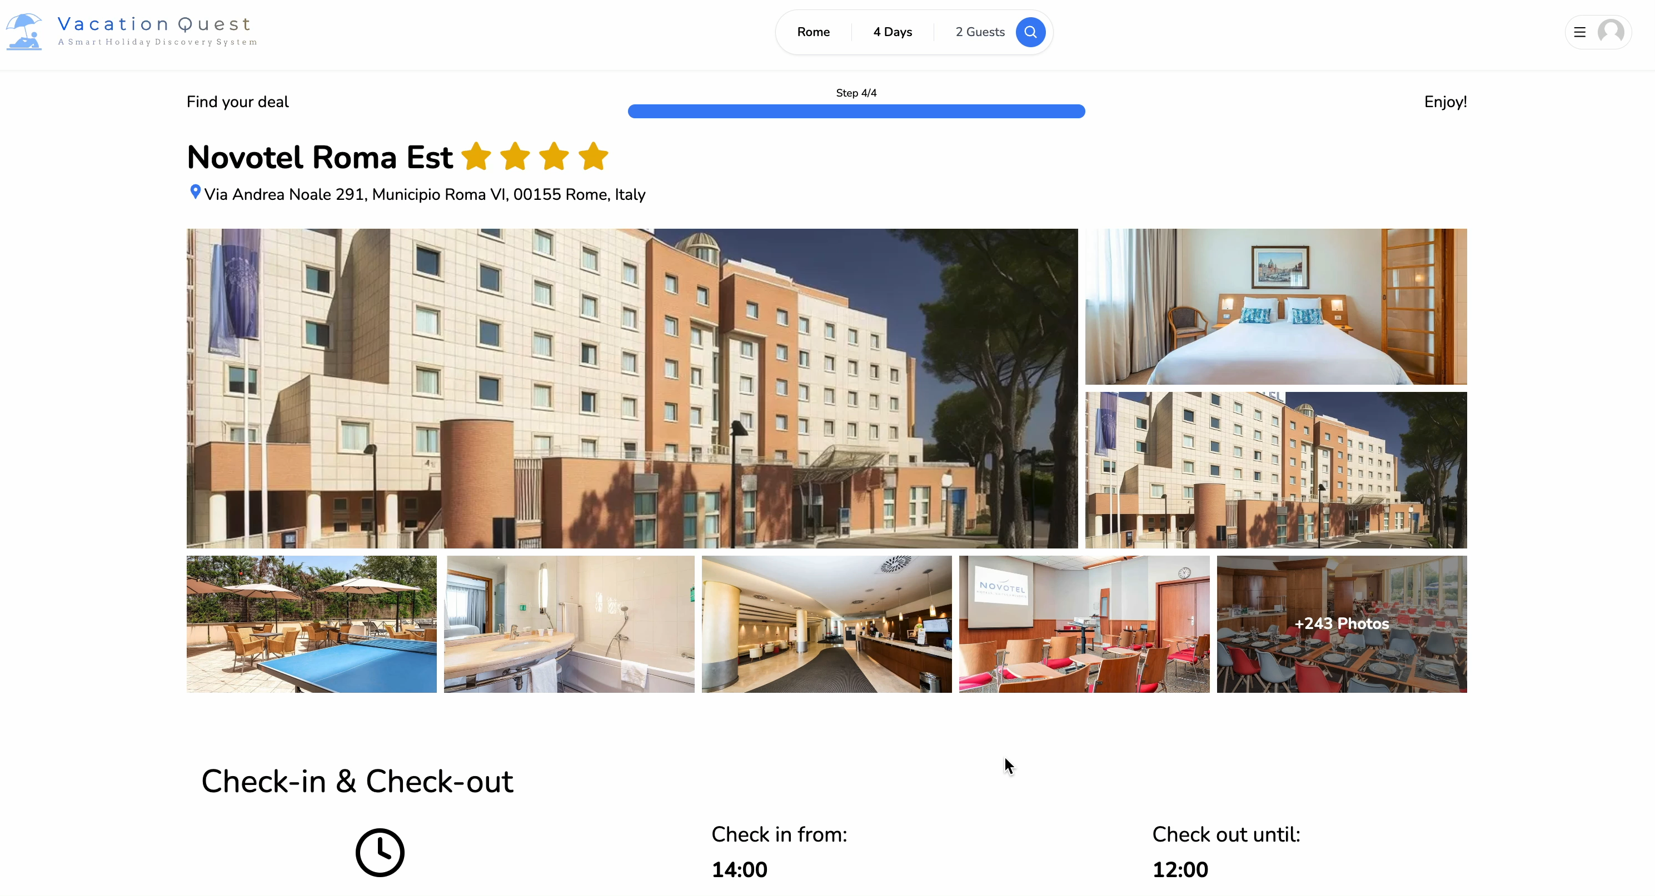
Implementation – Accommodation page
Notes:
Gallery
Check-in & out times
Map Amenities
Price comparison Similar Hotels to this hotel
And Dor will continue to talk about the uniqueness of our approach

Slide 14
Uniqueness of the approach
More convenient for the customer
Saves time
Each customer gets more accurate results
Leveraging AI & ML technologies
Notes:
The uniqueness of our approach is that our website helps our customer to book his vacation in a more convenient way when he has in one website all the information he need.
Saving time is a result of comparing the prices of different agencies in one website.
Each customer gets more accurate results that fit his needs
And finally, we are leveraging AI & ML technologies to fulfill our goals.

Slide 15
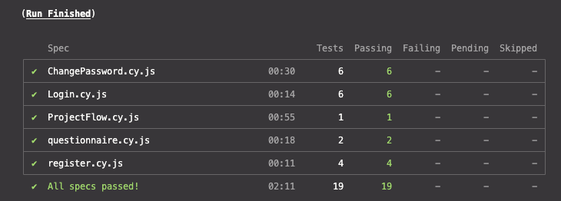
Testing - Cypress

Slide 16



Thank you for listening!

